Slide 1
Results for the City of Prior Lake
August 24th, 2022

Slide 2
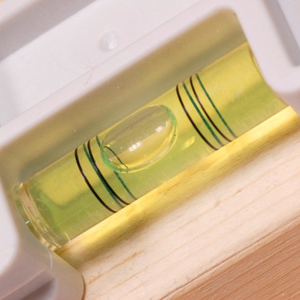
Role of Resident Surveys in Local Governance
Monitor trends in resident opinion
Measure government performance
Inform budget, land use, strategic planning decisions
Benchmark service ratings

Slide 3
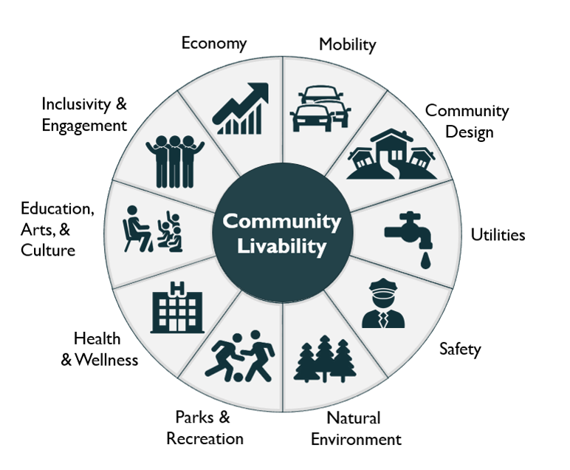
Facets of Community Livability
3

Slide 4
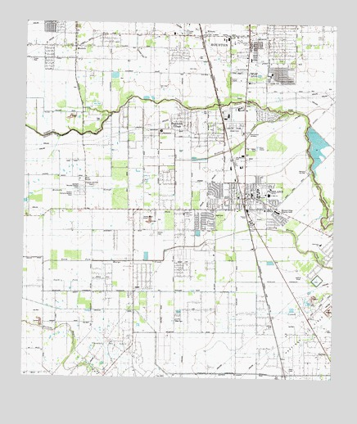
The National Community Survey™ in Prior Lake
The NCS™ for Prior Lake, MN
First time conducting The NCS
Scientific multi-contact sample of 2,800 households
519 total responses received, 19% overall response rate
Results statistically weighted to reflect Prior Lake overall
95% confidence interval with a +/- 4.3% margin of error

Slide 5
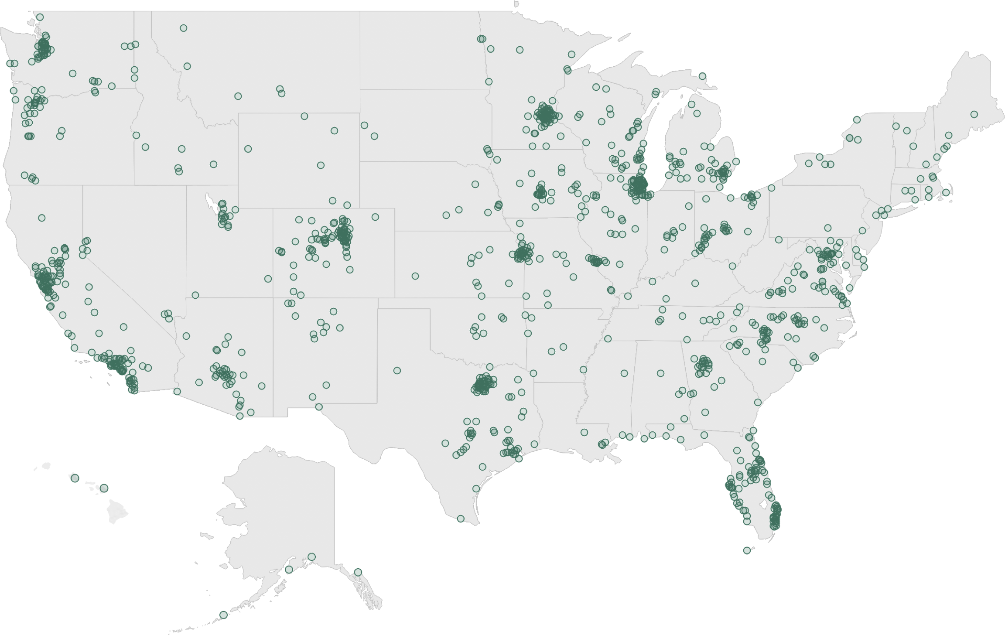
National Benchmark Comparison Database
More than 500 comparison communities across the nation.
Representing the opinions of more than 50 million residents.

Slide 6
Overview of Survey Results

Slide 7
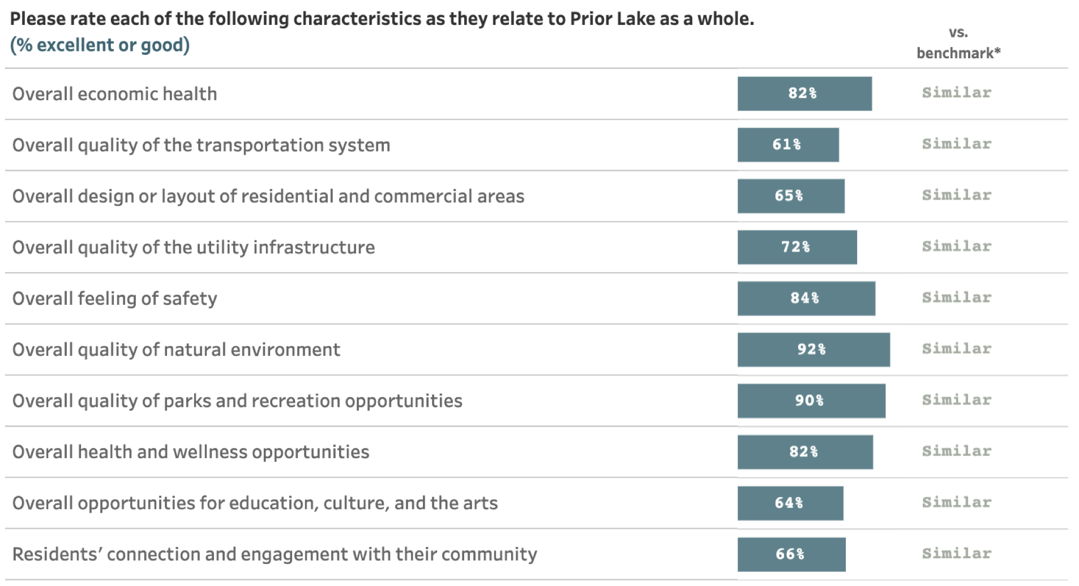
Facets of Community Livability: Quality

Slide 8
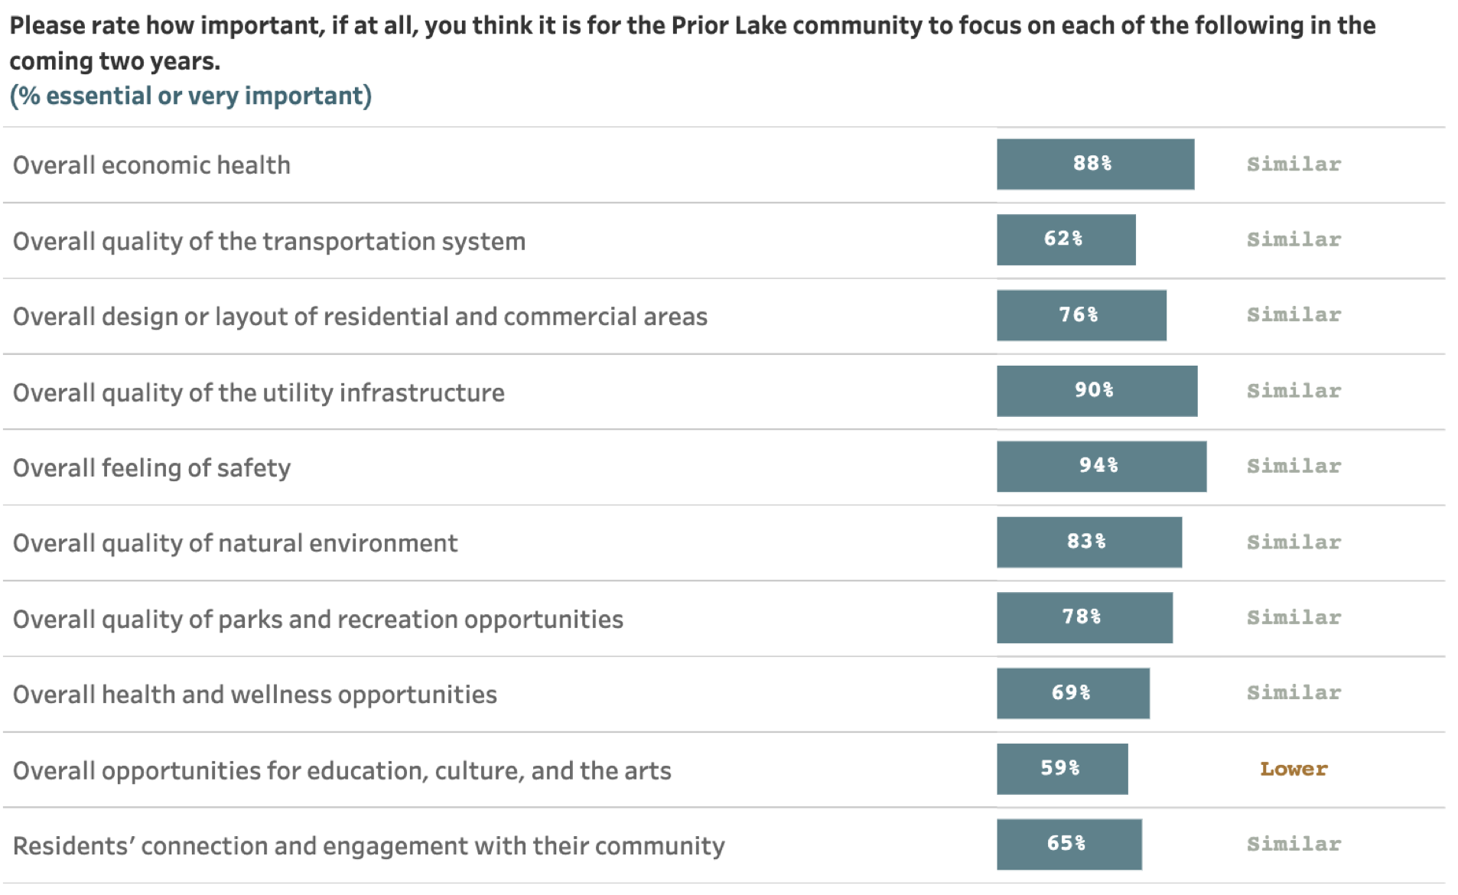
Facets of Community Livability: Importance

Slide 9
Comparisons to National Benchmarks
Air Quality
Cleanliness
Available Paths/Trails
Water Resources
Street Cleaning
Sidewalk Maintenance
Snow Removal
7
received more positive ratings
114
received similar ratings
2
received more negative ratings
Use Public Transportation
Opps Art, Culture, & Education

Slide 10
Survey Highlights

Slide 11
Prior Lake residents enjoy a positive quality of life
Key Finding #1:

Slide 12
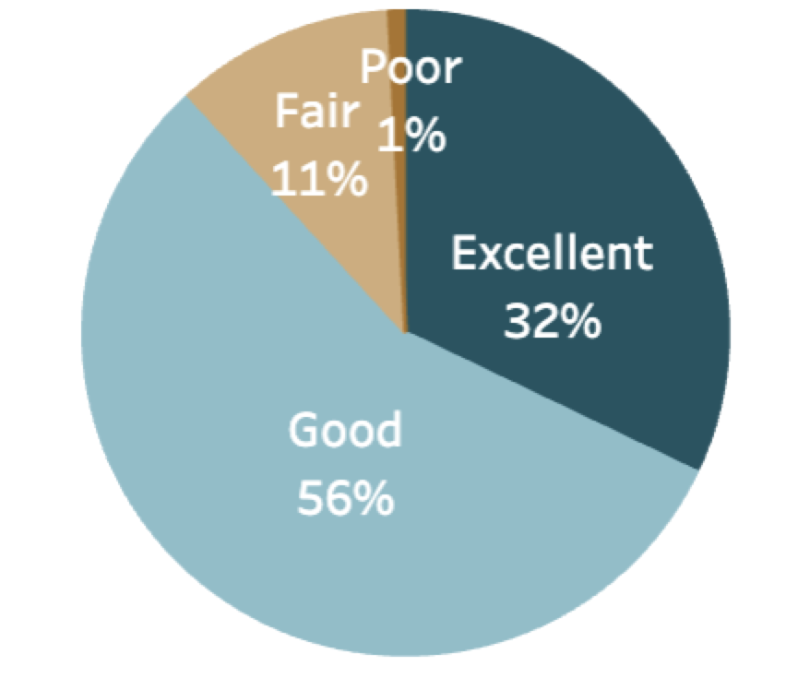
Overall Community Quality
The overall quality of life in Prior Lake
About
9 in 10
residents gave excellent or good ratings to:
8 in 10 residents also positively rated:
The overall image or reputation of Prior Lake
Prior Lake as a place to raise children
- Prior Lake as a place to live
- The overall quality of life in Prior Lake
- Would recommend Prior Lake as a place to live
- Plan to remain in Prior Lake for next 5 years

Slide 13
Prior Lake’s economy is a strong community feature
Key Finding #2:

Slide 14
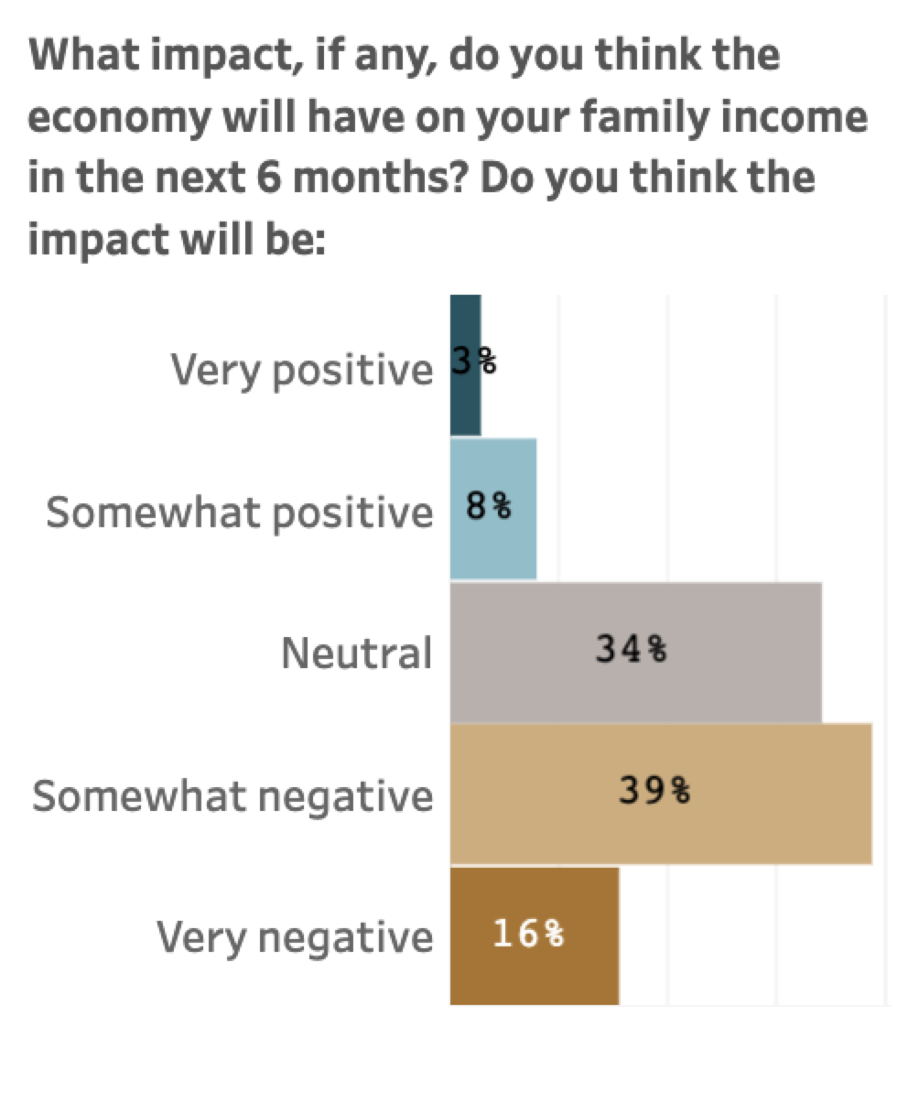
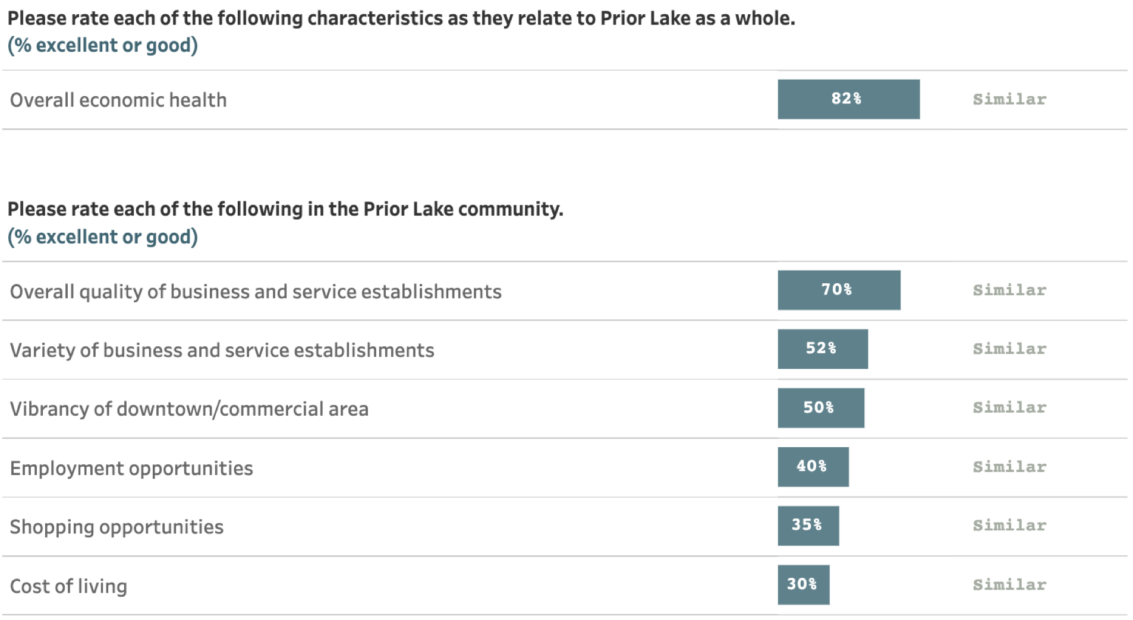
Public Trust
The Economy in Prior Lake
61% of residents rated Prior Lake’s economic development as excellent or good

Slide 15
Most residents feel a strong sense of safety in the city
Key Finding #3:

Slide 16
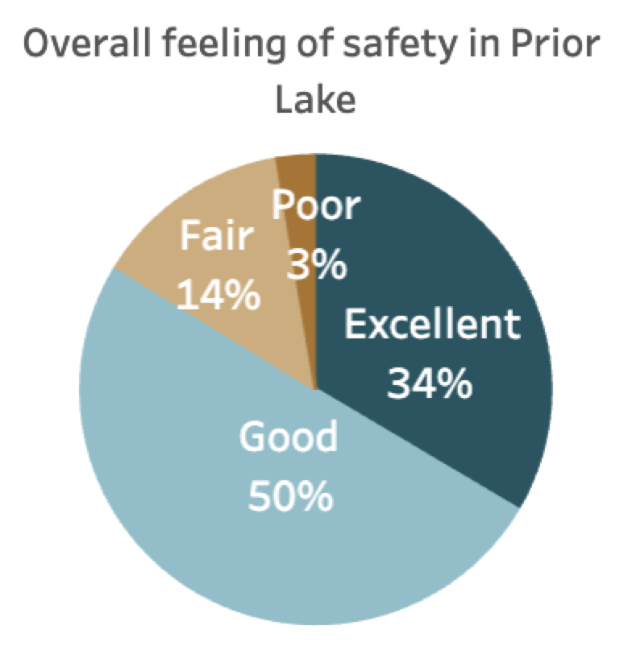
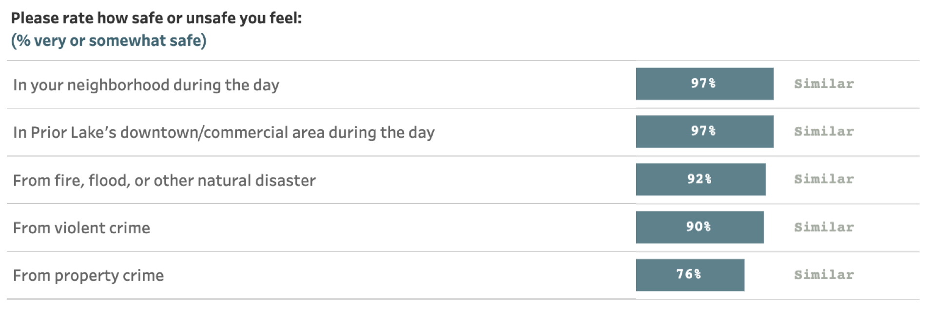
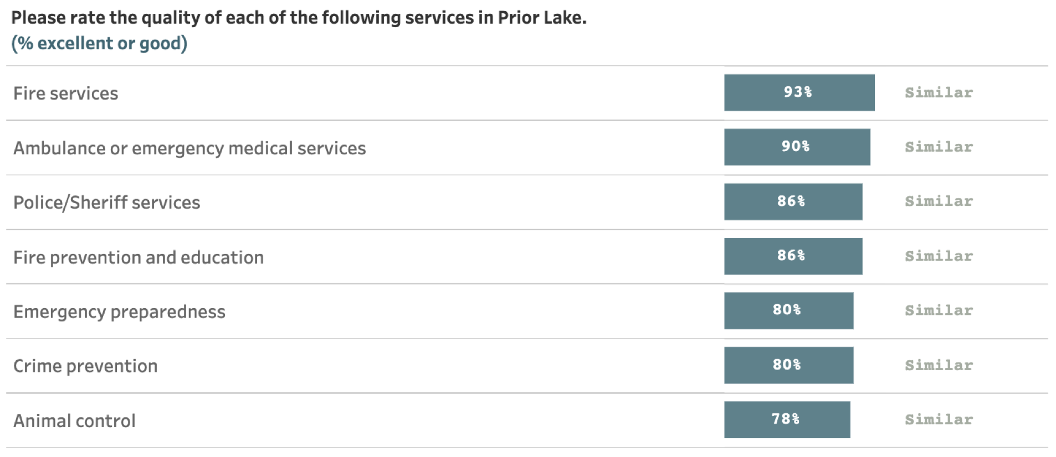
Safety in Prior Lake

Slide 17
Residents appreciate Prior Lake’s natural environment and recreational opportunities
Key Finding #4:

Slide 18
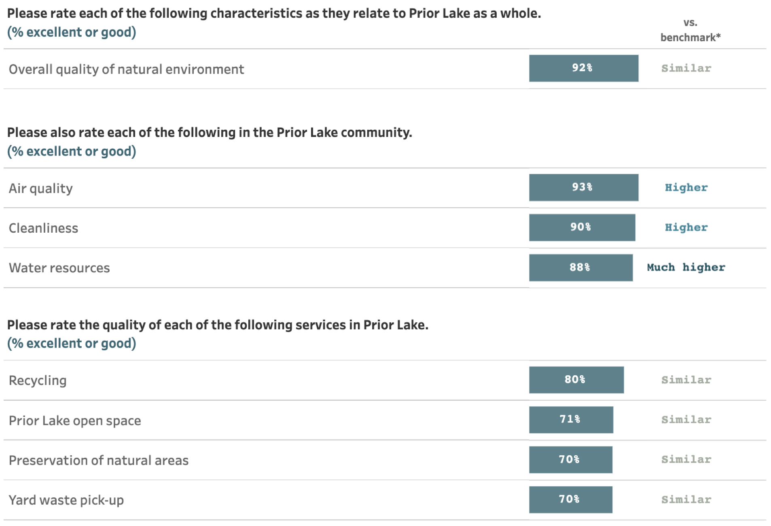
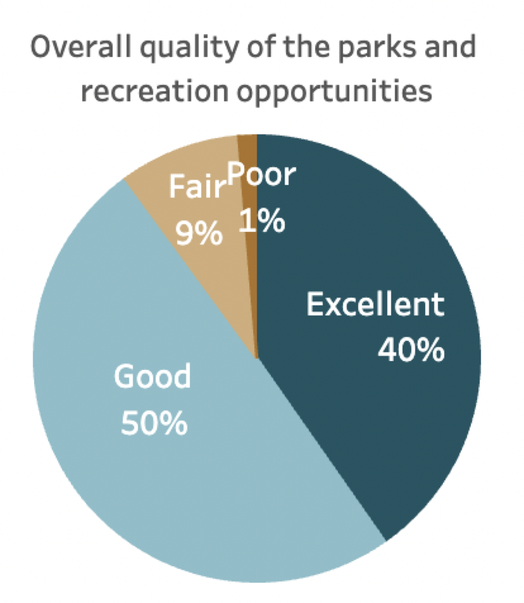
Natural Environment and Parks and Recreation in Prior Lake
8 in 10 residents positively reviewed:
Prior Lake’s recreation programs or classes
Recreational opportunities
Fitness Opportunities

Slide 19
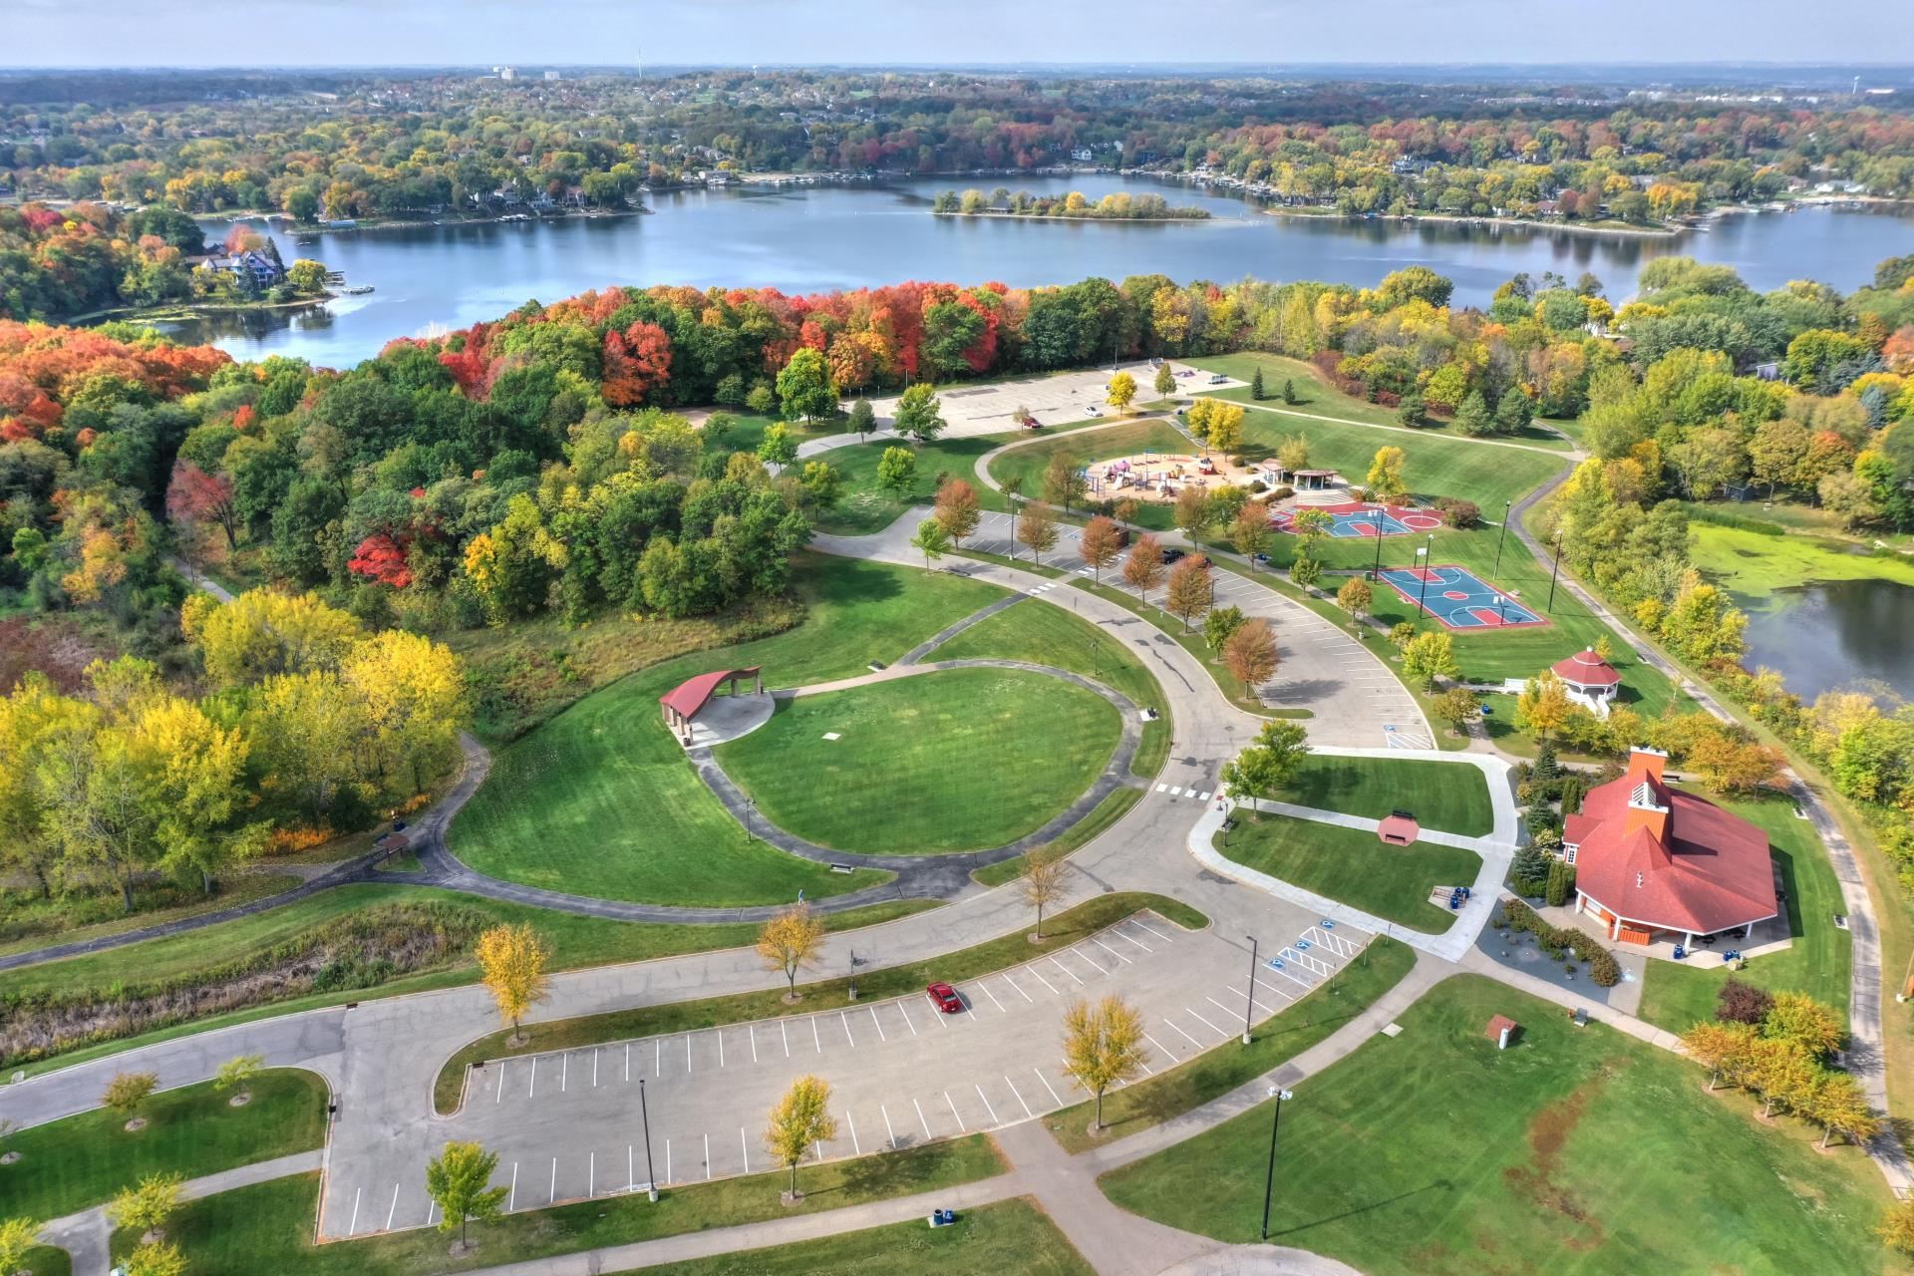
Natural Environment and Parks and Recreation in Prior Lake
During the past few years, on average, how often did you use or participate in the following in Prior Lake?

Slide 20
Natural Environment and Parks and Recreation in Prior Lake
Please rate the quality of each of the following existing parks and recreation facilities and amenities in Prior Lake

Slide 21
Natural Environment and Parks and Recreation in Prior Lake
Please indicate how much of a priority, if any, you feel each of the following should be within the Prior Lake community

Slide 22
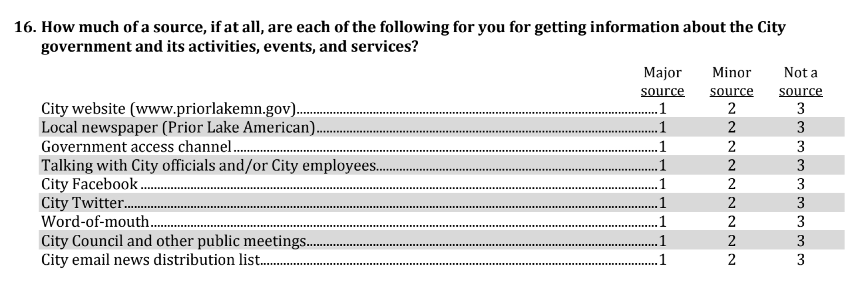
Additional Special Topics

Slide 23
City Communication
How much of a source, if at all, are each of the following for you for getting information about the City government and its activities, events, and services?
Percent major source

Slide 24
Prior Lake residents enjoy a positive quality of life.
Prior Lake’s economy is a strong community feature.
Most residents feel a strong sense of safety in the city.
Residents appreciate Prior Lake’s natural environment and recreational opportunities.
Conclusions

Slide 25
Questions?

