Slide 1




Results for the City of Prior Lake
August 24th, 2022

Slide 2




Civic Communication & Analytics Platform
Smarter, better connected communities. A civic surveying, policy polling, and constituent communication tech platform.
Advanced Survey Science & Performance Analytics
Data insights to help communities move forward.
The premiere provider of professional civic surveys
and performance benchmarking analyses.
Exclusive partners of:
Questions about our product?
Visit www.polco.us to learn more

Slide 3



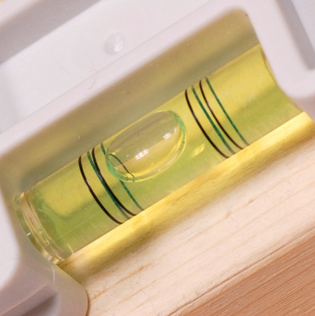
Role of Resident Surveys in Local Governance
Monitor trends in resident opinion
Measure government performance
Inform budget, land use, strategic planning decisions
Benchmark service ratings

Slide 4
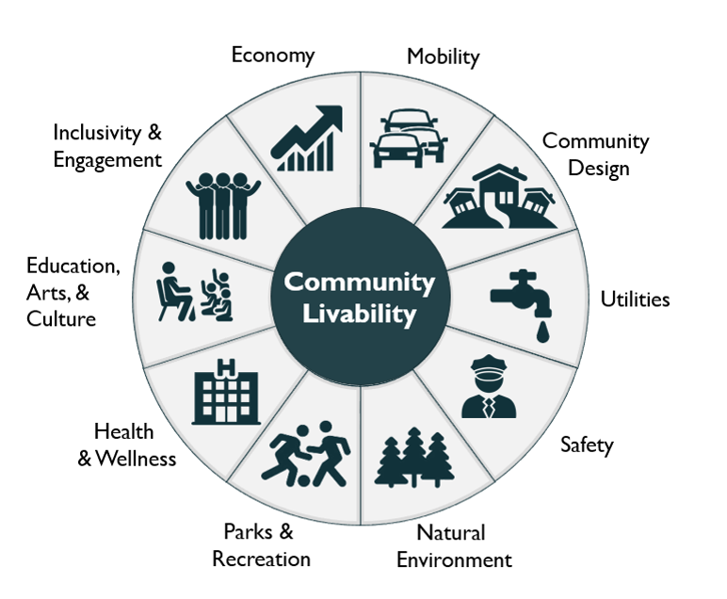
Facets of Community Livability
4

Slide 5
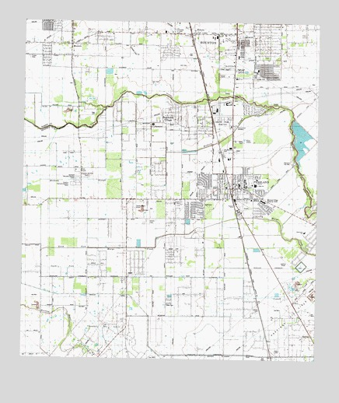
The National Community Survey™ in Prior Lake
The NCS™ for Prior Lake, MN
First time conducting The NCS
  Scientific multi-contact sample of 2,800 households
  519 total responses received, 19% overall response rate
  Results statistically weighted to reflect Prior Lake overall
95% confidence interval with a +/- 4.3% margin of error

Slide 6
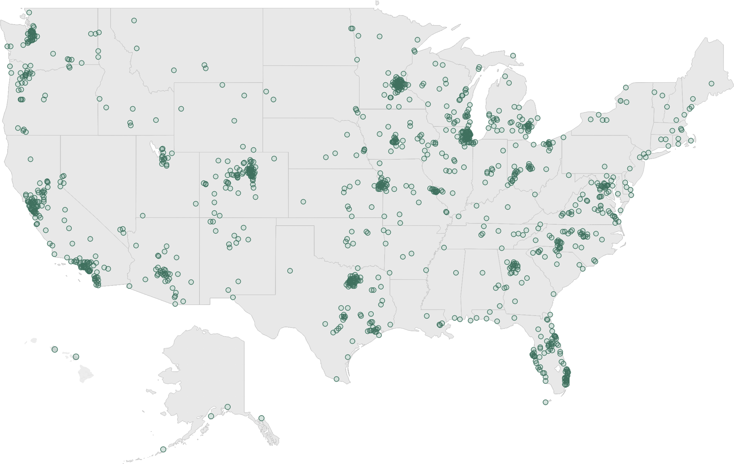
National Benchmark Comparison Database
More than 500 comparison communities across the nation.
Representing the opinions of more than 50 million residents.

Slide 7
Overview of Survey Results

Slide 8
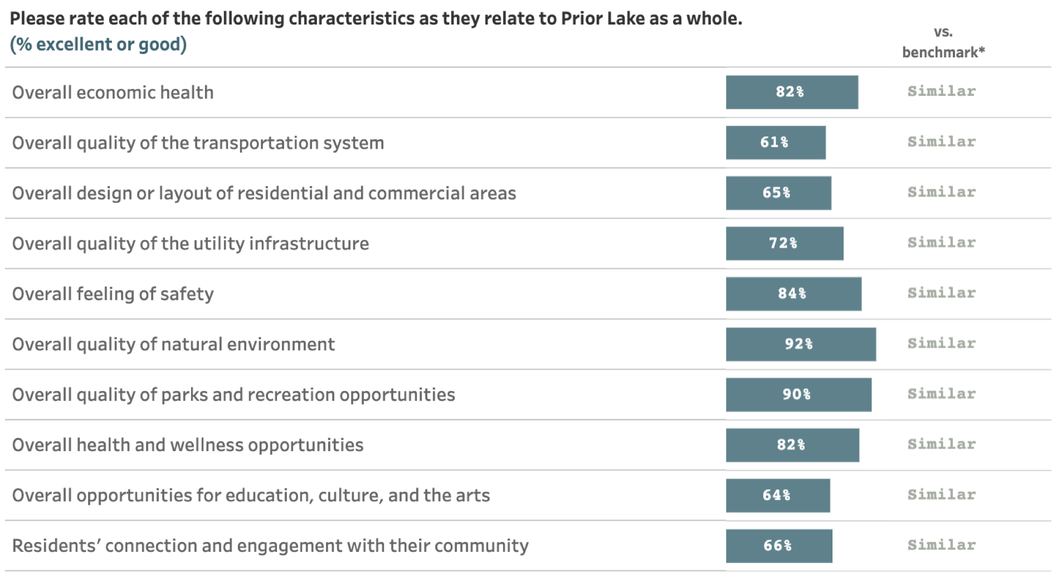
Facets of Community Livability:
Quality

Slide 9
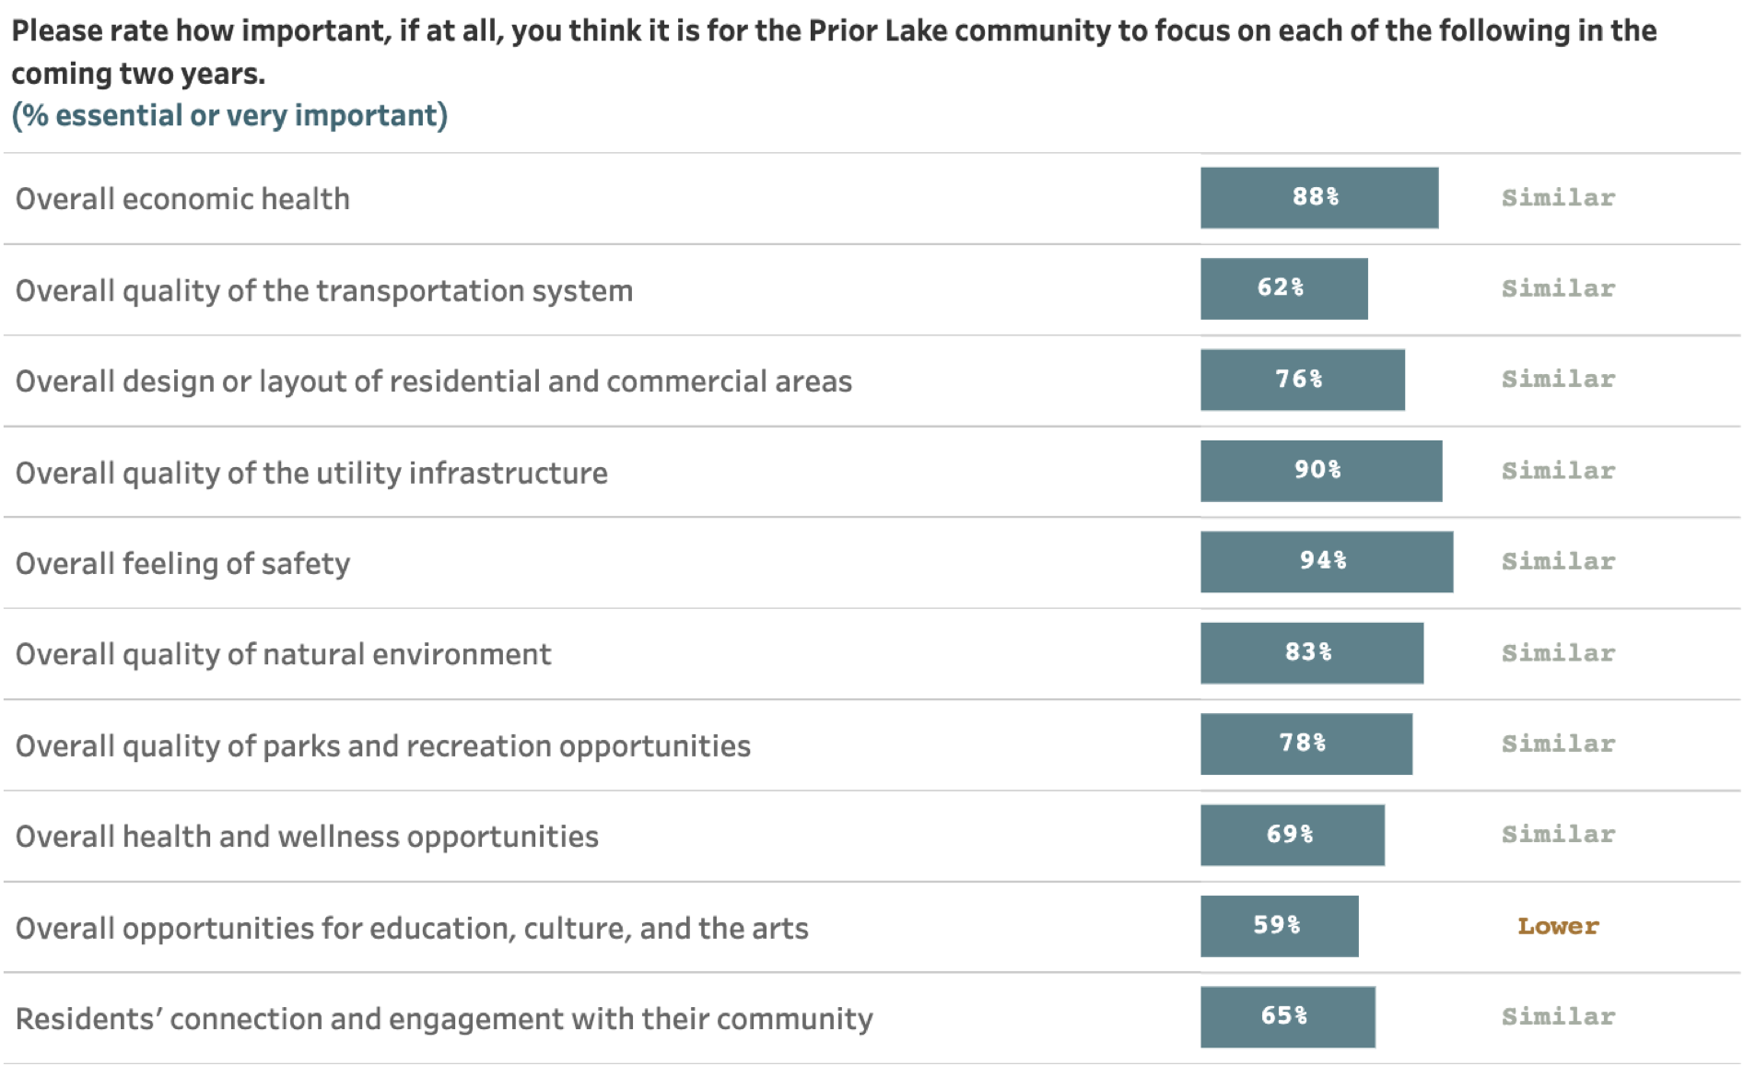
Facets of Community Livability:
Importance

Slide 10
Comparisons to National Benchmarks
6
received
more positive
ratings
116
received similar
ratings
1
received more negative ratings

Slide 11
Survey Highlights

Slide 12


Prior Lake residents enjoy a positive quality of life
Key Finding #1:

Slide 13
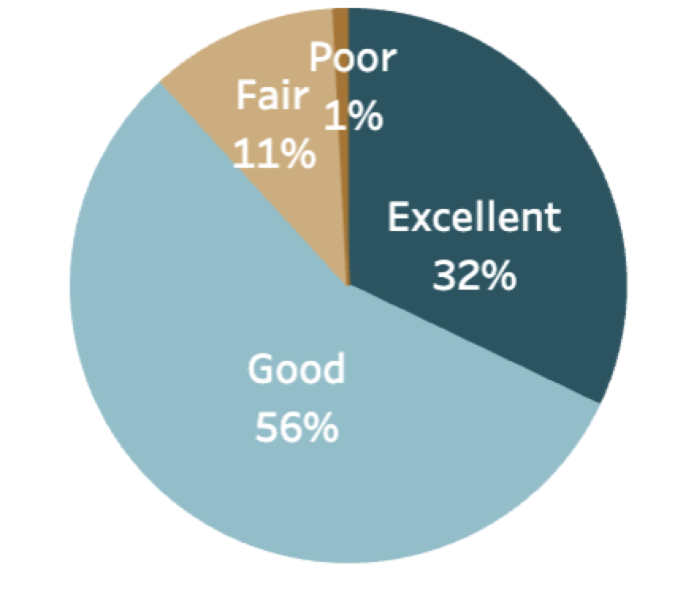
Overall Community Quality
The overall quality of life in Prior Lake
About
9 in 10
residents gave excellent or good ratings to:
8 in 10 residents also positively rated:
The overall image or reputation of Prior Lake
Prior Lake as a place to raise children
- Prior Lake as a place to live
- The overall quality of life in Prior Lake
- Would recommend Prior Lake as a place to live
- Plan to remain in Prior Lake for next 5 years

Slide 14

Prior Lake’s economy is a strong community feature
Key Finding #2:

Slide 15
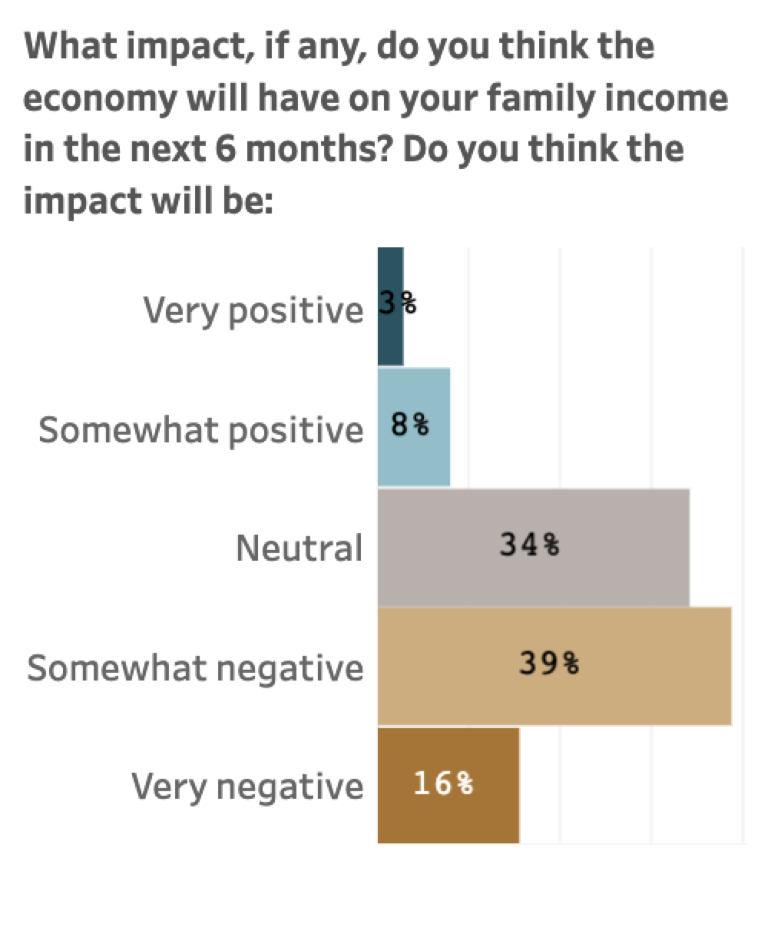
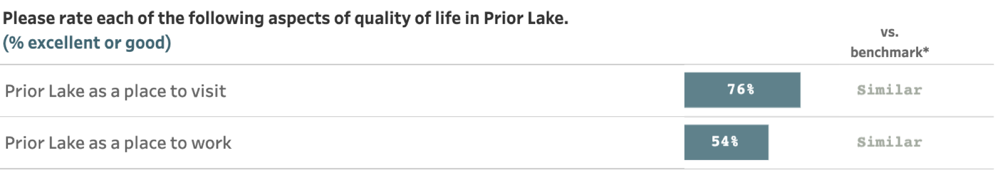
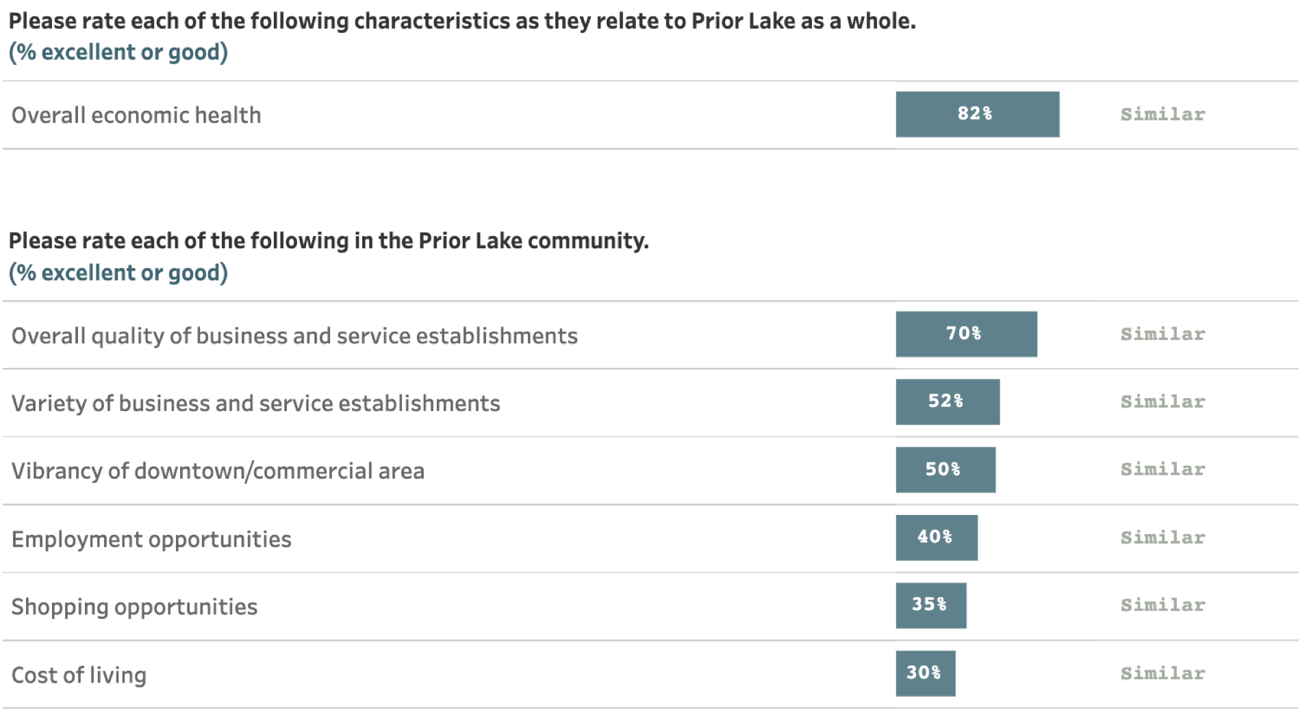
Public Trust
The Economy in Prior Lake
61% of residents rated Prior Lake’s economic development as excellent or good

Slide 16

Most residents feel a strong sense of safety in the city
Key Finding #3:

Slide 17
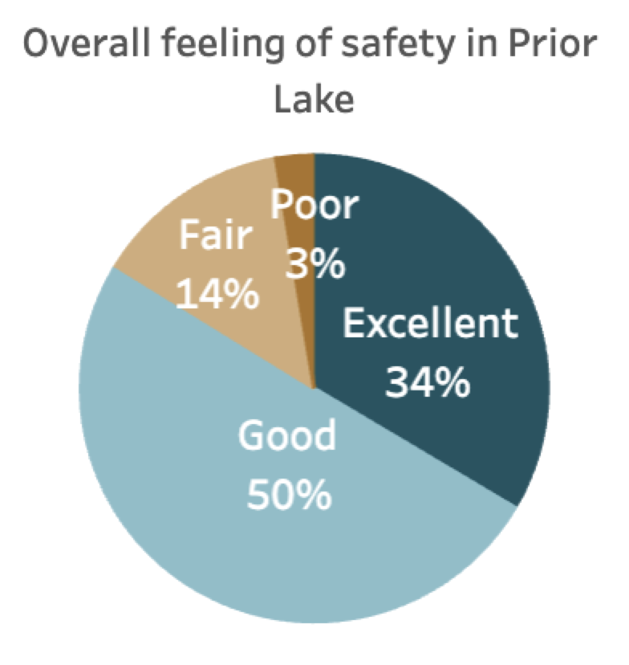
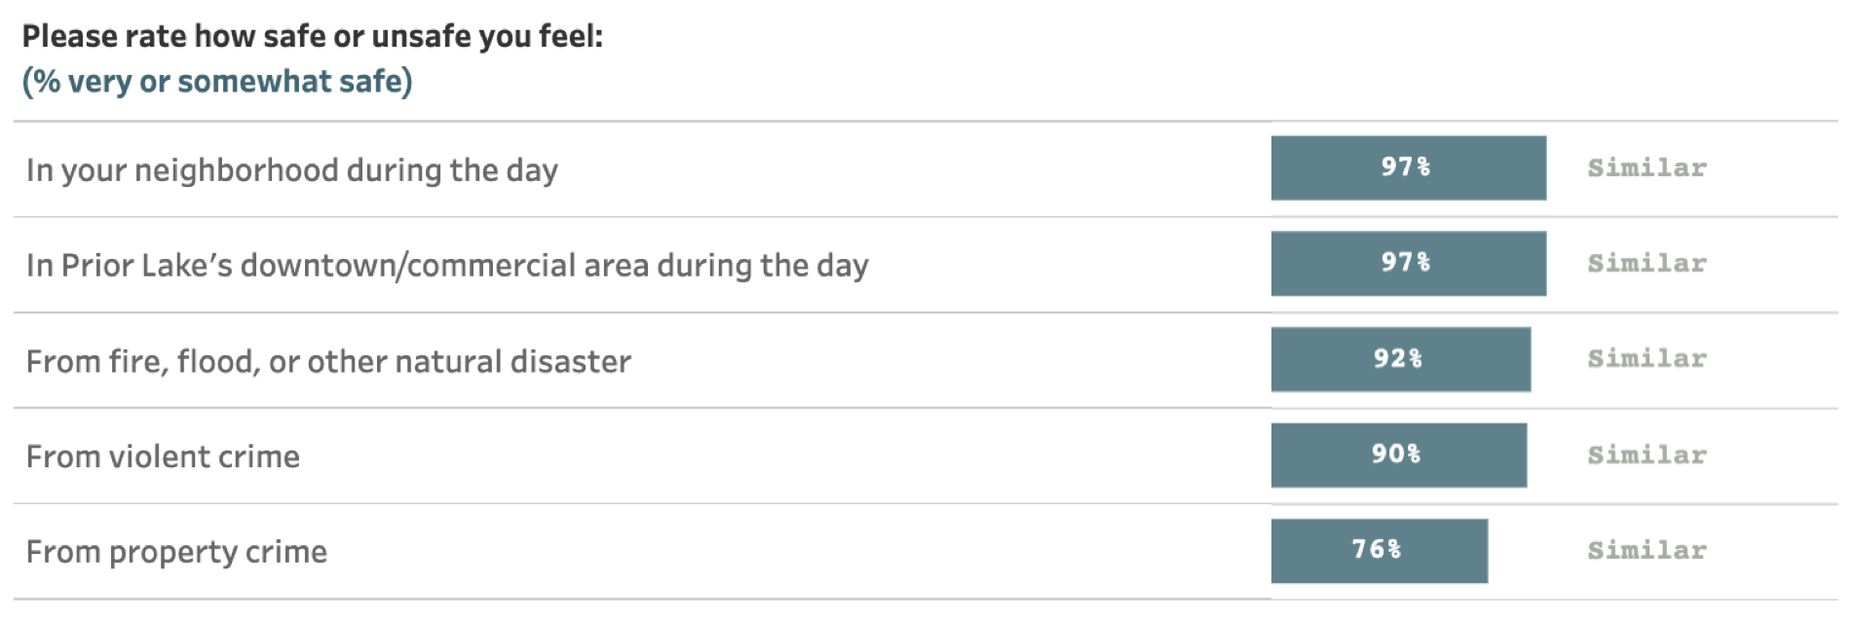
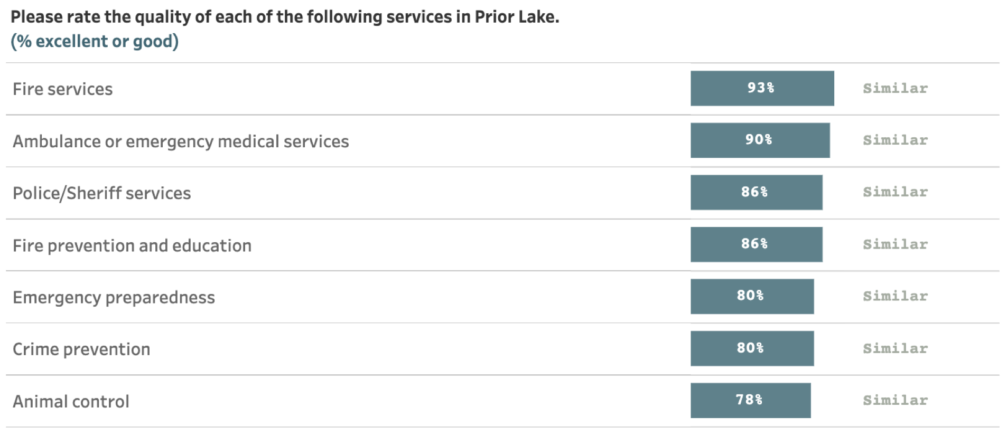
Safety in Prior Lake

Slide 18

Residents appreciate Prior Lake’s natural environment and recreational opportunities
Key Finding #4:

Slide 19
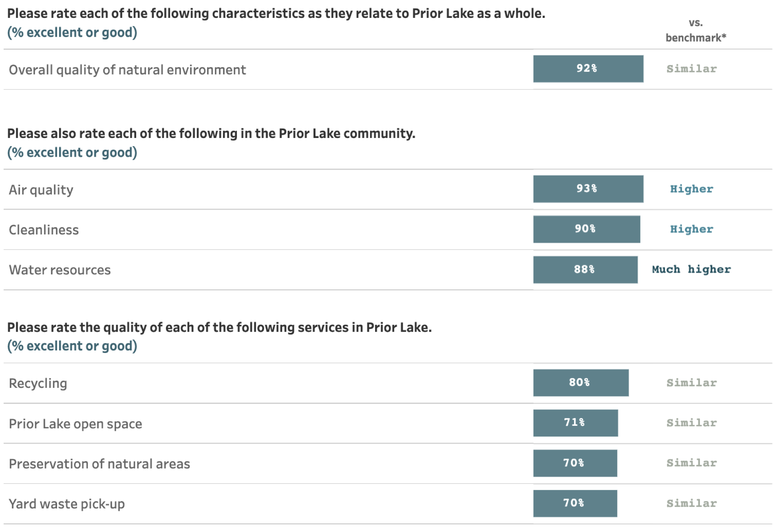
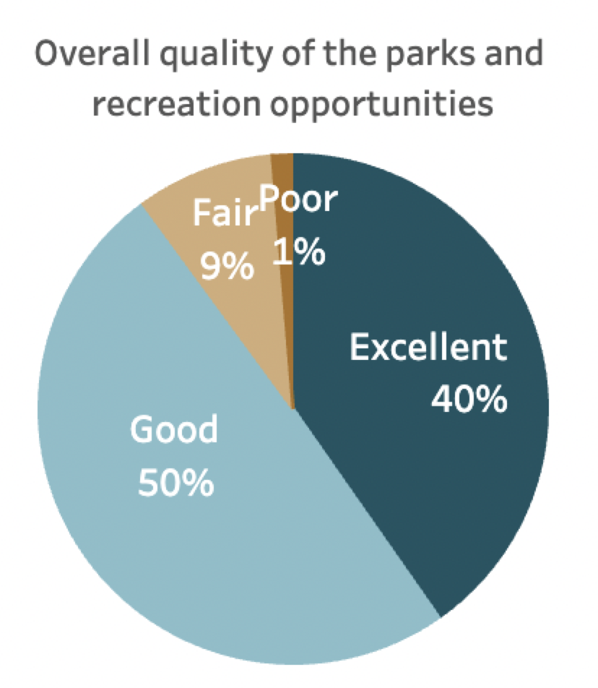
Natural Environment and Parks and Recreation in Prior Lake
8 in 10 residents positively reviewed:
Prior Lake’s recreation programs or classes
Recreational opportunities
Fitness Opportunities

Slide 20
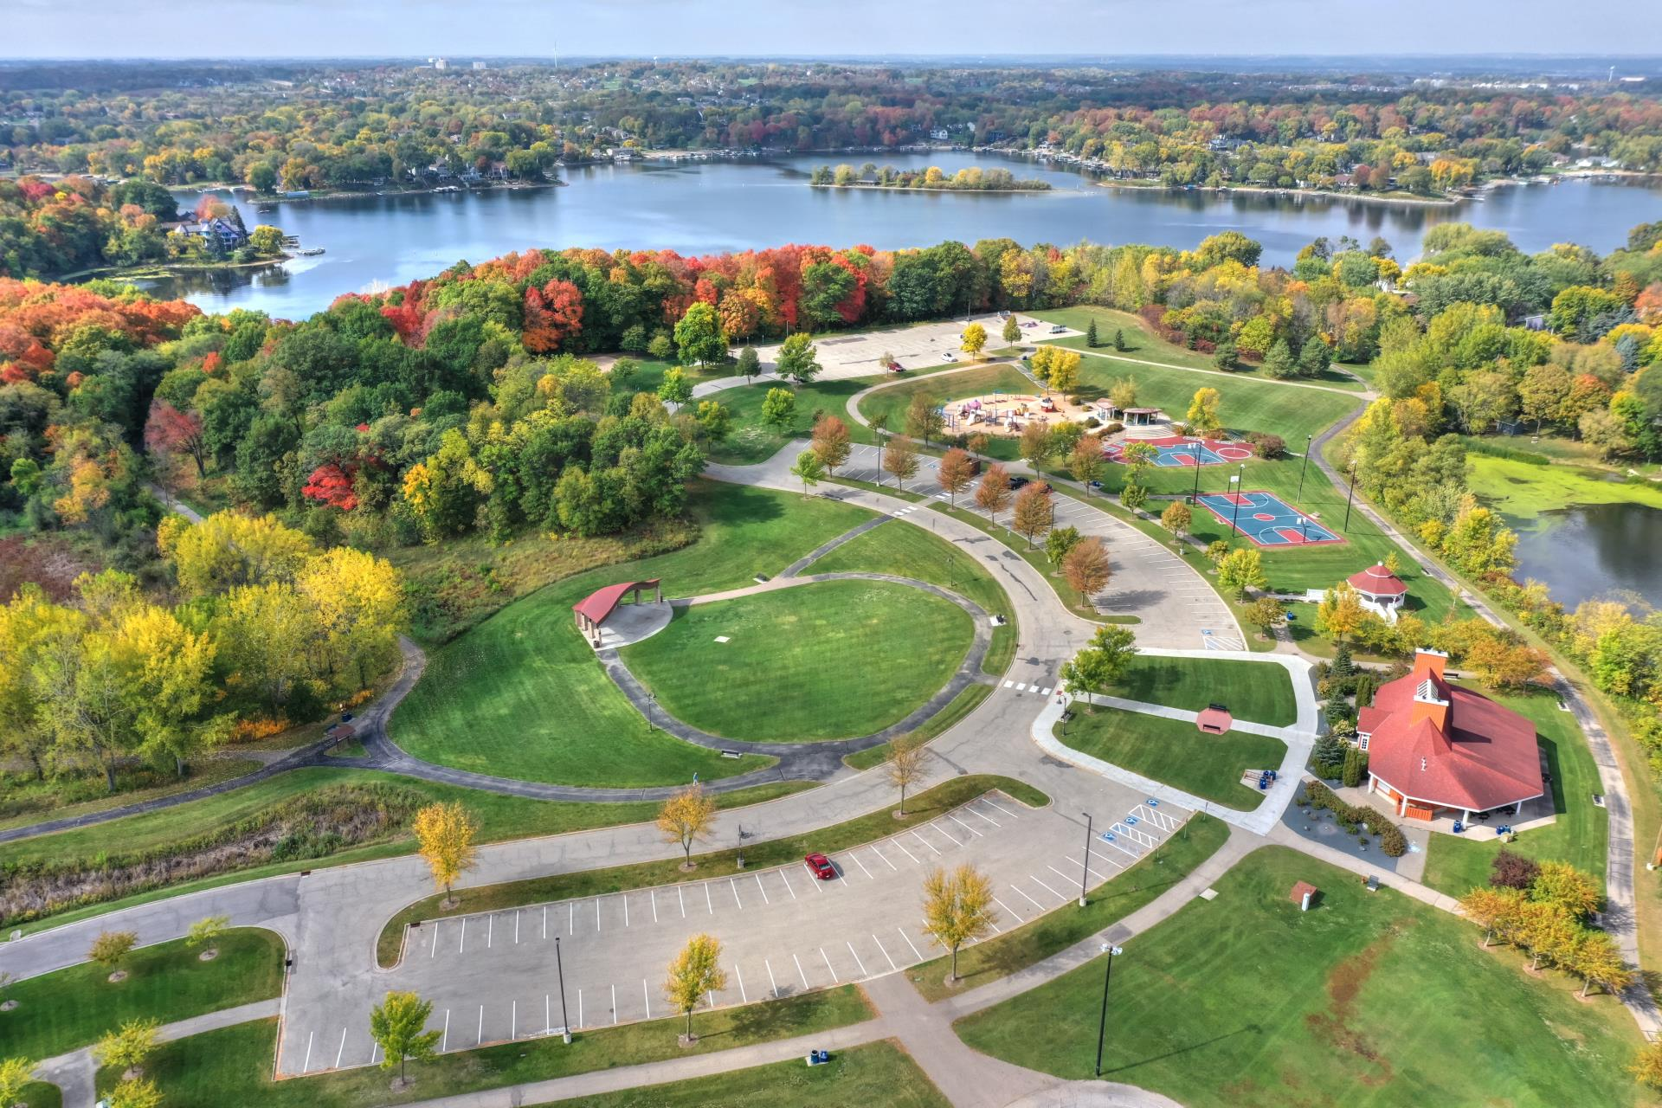
Natural Environment and Parks and Recreation in Prior Lake
During the past few years, on average, how often did you use or participate in the following in Prior Lake?

Slide 21
Natural Environment and Parks and Recreation in Prior Lake
Please rate the quality of each of the following existing parks and recreation facilities and amenities in Prior Lake

Slide 22
Natural Environment and Parks and Recreation in Prior Lake
Please indicate how much of a priority, if any, you feel each of the following should be within the Prior Lake community

Slide 23
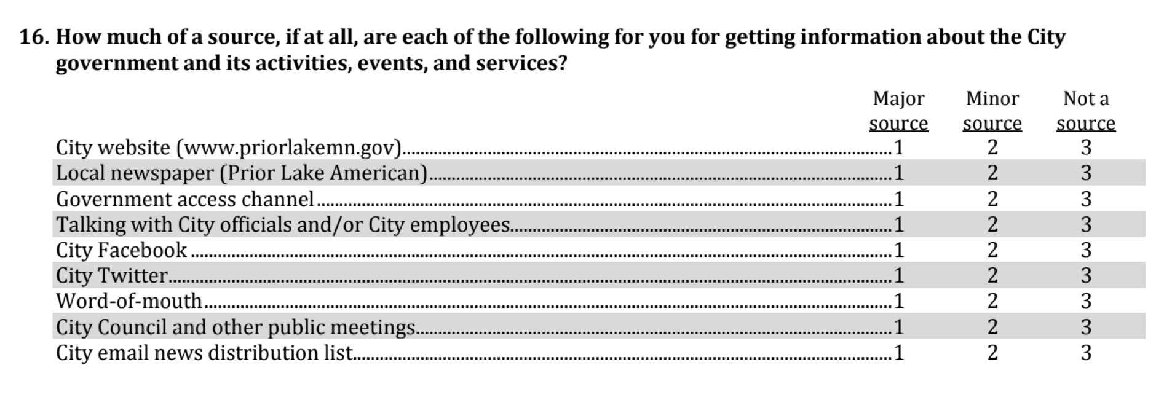
Additional
Special Topics

Slide 24
City Communication
How much of a source, if at all, are each of the following for you for getting information about the City government and its activities, events, and services?
Percent major source

Slide 25
Prior Lake residents enjoy a positive quality of life.
Prior Lake’s economy is a strong community feature.
Most residents feel a strong sense of safety in the city.
Residents appreciate Prior Lake’s natural environment and recreational opportunities.
Conclusions

Slide 26

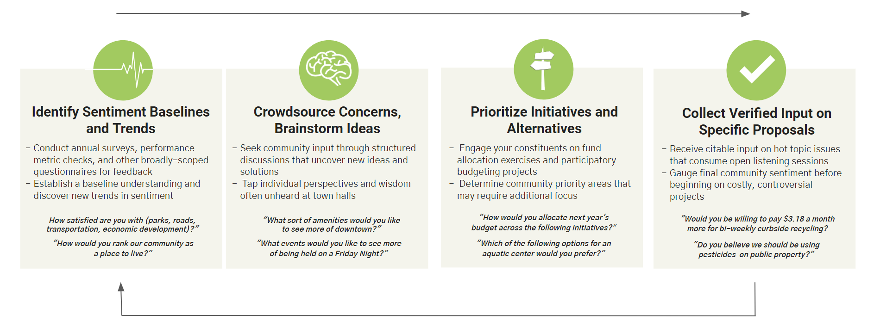
Continue Engagement Through The Policy Lifecycle
Don't let the community input and dialogue conclude with the survey.
Identify opportunities for improvement. Engage along the way to cultivate buy-in. Demonstrate progress. Repeat.

Slide 27
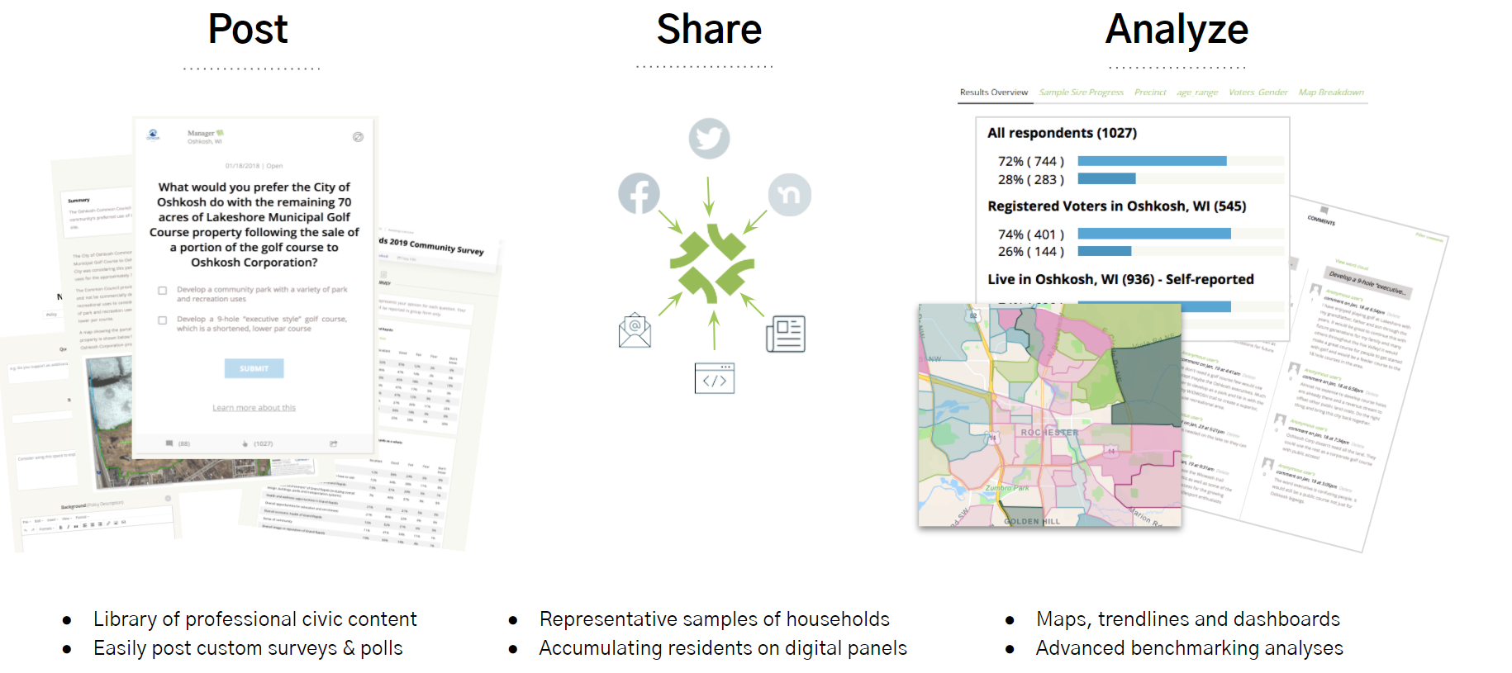
It’s Easy To Continue To Engage Your Panel

Slide 28
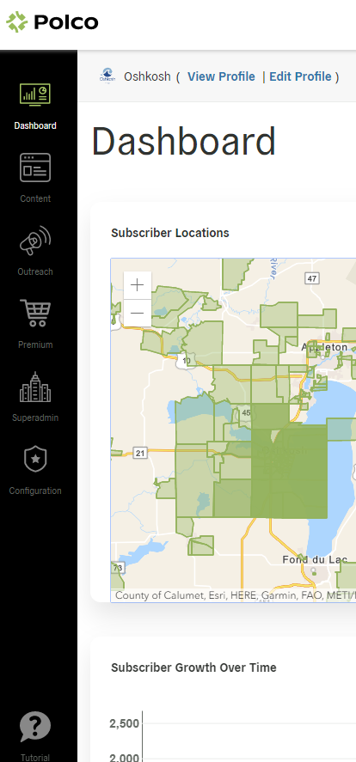
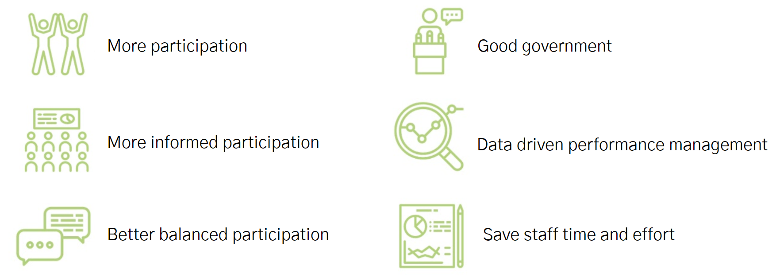
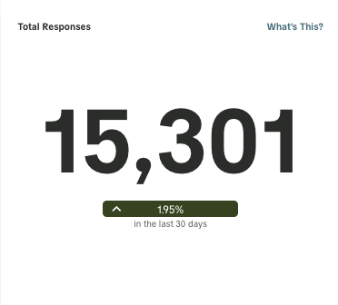
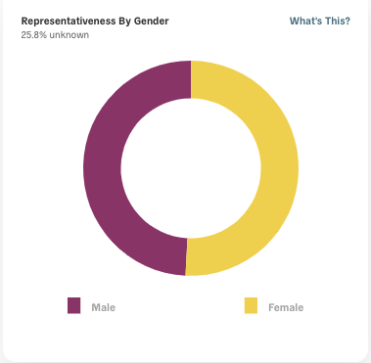
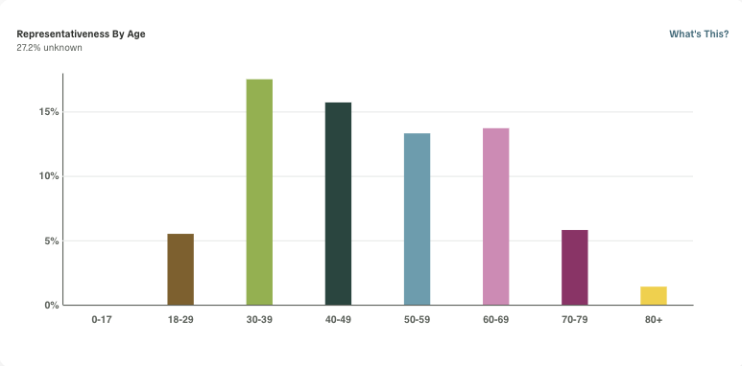
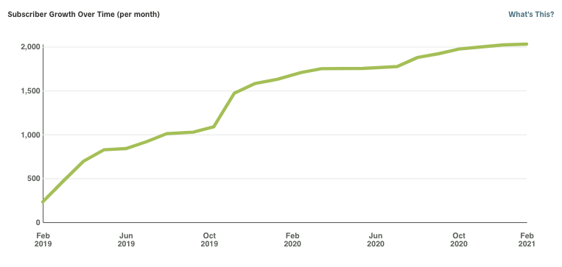
The Process To Deliver Great Outcomes

Slide 29
Questions?

Slide 30
Thank you!
Damema Mann
Director of National Engagement
Polco/National Research Center
damema@polco.us

